Slide 1
Essay on Mark Weiser's Vision
In Mark Weiser's vision, a ubiquitous computing environment refers to a network of interconnected devices and systems seamlessly integrated into everyday life. In your living room, this concept can be realized through a variety of smart devices and technologies working together to create a seamless and enhanced living experience.
Here's a description of a potential ubiquitous environment for your living room: The ubiquitous setting in my living room:
Smart Lighting: Imagine intelligent lighting fixtures capable of automatically adjusting their brightness, color, and warmth based on factors like your preferences, natural lighting conditions, or specific activities engage in. These lights can also be controlled remotely through a mobile app or voice commands.
Automated Entertainment: A central hub or smart TV can integrate my preferred entertainment services, such as streaming platforms or cable TV, and provide personalized recommendations based on viewing habits. Voice commands or a dedicated remote app can control the system, enabling to start, pause, or switch between content seamlessly.
IoT Integration: Various Internet of Things (IoT) devices can enhance the living room experience. For example, a smart thermostat can regulate the room temperature according to preferences and patterns, ensuring optimal comfort. Connected speakers or sound systems can provide high-quality audio and be synchronized with other devices throughout the home.
Intelligent Assistants: Virtual assistants like Amazon Alexa, Google Assistant, or Apple Siri can be integrated into the living room, enabling voice-controlled interactions with devices and providing information, reminders, and assistance on demand.
Advanced Security: A smart security system with cameras, sensors, and smart locks can monitor your living room and provide alerts or remote access control through a mobile app. This technology ensures the safety of my home and allows me to manage access for guests or service providers.
Home Automation: This automates various aspects of my living room, including curtains or blinds that open and close automatically based on my schedule or lighting conditions. Smart plugs can control devices like lamps or speakers, and a smart coffee maker can prepare your favorite brew as soon as you wake up.

Slide 2
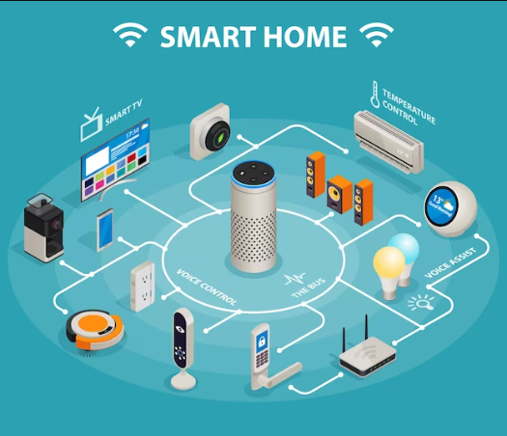
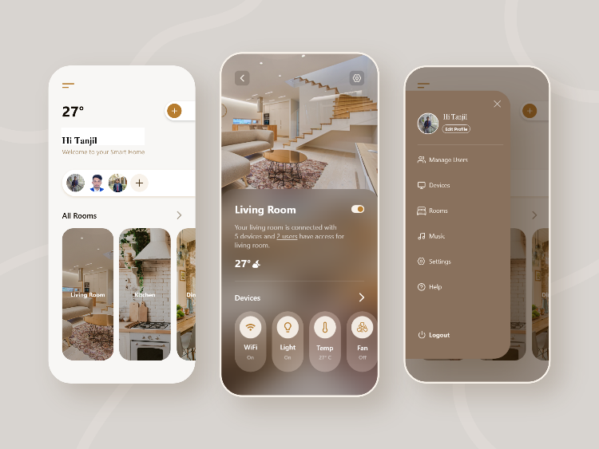
Sofa with Embedded Charging Ports: Wireless charging and power ports integrated into the furniture.
Smart Blinds/Curtains: Automated blinds that adjust based on sunlight or user commands.
Seamless Connectivity: My living room setting would be effortlessly connected to all of my gadgets, including smart appliances and cell phones. I can quickly switch from a video conference on my phone to a more immersive experience on the living room display if I'm in the middle of one.
Energy Efficiency: In my living area, energy efficiency would be my first concern. I would install sensors that could detect when the room is empty and adjust the temperature and lighting appropriately. I could use solar energy more responsibly to power my living room by mounting solar panels on the windows.
According to Mark Weiser's concept, a ubiquitous living room will be a technologically advanced space that will improve my everyday life and easily adjust to my needs while staying in the background so as not to overwhelm me with technology.

